Slide 1
Mobile Application Development
Games Academy June 2015 - Day 1
Benjamin Nitschke - Delta Engine

Slide 2
About me: BenjaminNitschke.com
2002-2004: First commercial .NET Game: Arena Wars
2005: Rocket Commander Tutorial, 1 Million Views
2006: Wrote Professional XNA Game Programming Book
2008: meinSport.de Online Sport Community Site
2009: FireBurst Xbox, PlayStation, PC with Unreal Engine
2010: Released Games on iOS, Android, WinPhone, W8 ..
2012: SoulCraft Mobile RPG (10+ Million Downloads)
since 2012: CEO Delta Engine, .NET, C++, JS Conversion
Notes:
2006: Created XNA Racing Game, one of the first full hd games on Xbox 360 and very popular XNA showcase game, got around 1 million youtube views
Current interests are compilers, functional languages and engines in general. I am also creating a new low level computer language that can write itself for future work. Most recently learned and used Clojure, Lisp and F#, worked on a few smaller games with our engine and some bigger contract work (native iOS, Android development), also helped SoulCraft development and just released it on Steam this week.

Slide 3
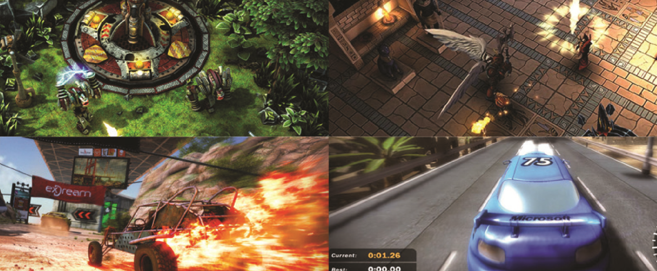
About me: Games created
Notes:
Arena Wars (2002-2004), SoulCraft (2012), Fireburst (2009) and XNA Racing Game (2006)

Slide 4
We will create many Space Invaders :)
Day 1: Platforms Overview
Windows, Windows 8, Windows Phone
Visual Studio: C++, C#
Day 2: Open Source Platforms
Linux, Android
Gcc: C++, Eclipse, IntelliJ: Java
Day 3: Apple Platforms
MacOS, iOS
XCode: Objective-C
Notes:
We will get a quick overview about each of these languages, but it is not important to be an expert in any of them as we will focus on the actual platform concepts, which are valid beyond languages and engines.

Slide 5
What about all these languages?
Each platform has its own culture, APIs and best supported language.
However many concepts are similar or the same
OpenGL is supported on all non Microsoft platforms
UI is vastly different and hard to share
Low level code (C/C++) runs on any platform
Okayish if you have existing code or an engine
A lot more code required and too general (no UI, etc.)
Notes:
Most games have their own UI and use engines that handle low level rendering, APIs and platform details, thus many of the points here do not matter in the real world, but they are still valid for low level programming and other aspects of mobile development.

Slide 6
Code base options Complexity
C++: Own or existing frameworks +++
C#: Not directly supported on all ++
Not even Microsoft supports C# well on non windows
Java: Only possible on some ++
Engine (less work, but also less flexible) +
Unity3D
Unreal
CryEngine
etc.

Slide 7
What is most popular for games?
Unity3D
Unreal Engine
CryEngine
Source
Other: RPG, Blender, GameMaker, Construct, XNA, Quake, Doom, DE, etc.
Roll your own
Notes:
https://en.wikipedia.org/wiki/List_of_game_engines
Unity3D is really popular for smaller studios and indies, but Unreal Engine is also highly successful, especially for big studios and very complex fps and rpg games.
Most engines are written in C++ and allow scripting in it plus a scripting language like C#, Lua, JS, BluePrint, etc.
Pretty much all engines have become cross platform and support mobile even if they started on just one or a few similar platforms (e.g. Unity on Mac, Unreal on PC and then Consoles).

Slide 8

What are non game engine choices?
Notes:
http://www.appia.com/blog/key-programming-languages-for-mobile-developers
http://mashable.com/2014/01/21/learn-programming-languages/

Slide 9
What are non game engine choices?
Actually, there is no common ground!
C/C++: Compiles everywhere
Java: PC, Linux, Android
Objective-C: iOS, MacOS
HTML5/JavaScript: Web
C#: Microsoft Platforms: PC, W8, WP, Xbox
Python/Lua/Ruby/Scala/etc: Depends
Notes:
http://www.appia.com/blog/key-programming-languages-for-mobile-developers
http://mashable.com/2014/01/21/learn-programming-languages/

Slide 10
We will go the recommended route!
On each platform we use the provided tools
Windows 8: DirectX/C++ with Visual Studio
Windows Phone: DX/C++ with Visual Studio
Android: Java with Android Studio (IntelliJ)
Linux: C++ with gcc, can also do C#, Java, ...
Mac OSX: Objective-C with XCode
iOS (iPhone, iPad): Objective-C and Swift
Notes:
http://www.appia.com/blog/key-programming-languages-for-mobile-developers
http://mashable.com/2014/01/21/learn-programming-languages/

Slide 11
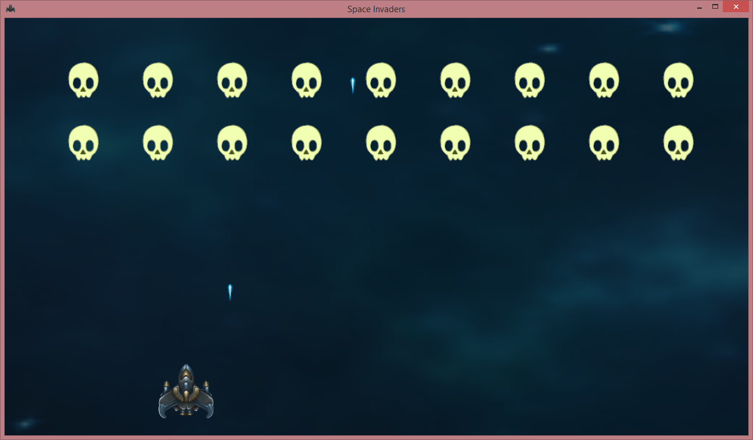
Target Game: Space Invaders
Notes:
Basic game and assets are coming from my previous C++ Basic Course, see https://github.com/BenjaminNitschke/CppCourse/tree/master/Day2

Slide 12
Let’s start coding (W8/WP8)
Open Visual Studio 2013
Select Store Apps (must have Windows 8)
Windows 8/Windows Phone support must be installed
Create a new C++ DirectX App (Universal App)
I will name mine “SpaceInvaders”
This will create 3 projects
SpaceInvaders.Windows (Windows 8.1)
SpaceInvaders.WindowsPhone (Windows Phone 8.1)
SpaceInvaders.Shared
Notes:
Visual Studio 2015 allows to create universal apps, which work on Windows 8, Windows Phone and Xbox One (all via Windows Universal Platform), but then again it is still very early and most scenarios are not really supported or even possible. Plus you need access to Xbox One SDK, which most do not have.

Slide 13
Why C++ and DirectX?
DirectX is only available directly in C++ Apps
via Create new C++ Store Apps -> DirectX App
MonoGame or SharpDX allow to write C# apps
Low level access to DirectX API via C#
Support Windows 8 & Windows Phone out of the box
C++ Samples are pretty much compatible
Can also create plain Win32 Windows Programs
Good enough for our use case, but we will use the deault way by the platform provider in this course!
Notes:
OpenGL won’t work directly on StoreApps (but works fine for normal windows apps).
C# Store App using SharpDX are possible too (via nuget) http://sharpdx.org/

Slide 14
DirectX and Sprite Rendering
DirectX is a 3D low level API
We just want to draw a few sprites
DirectX is a bit overkill, we could just use Xaml or HTML Canvas, but no real game uses that ..
DirectX Tool Kit to the rescue
Provides XNA/MonoGame like classes in C++
Tutorials and good documentation
Created by DirectX and XNA team members
Very performant :)
Notes:
OpenGL won’t work directly on StoreApps (but works fine for normal windows apps).
C# Store App using SharpDX are possible too (via nuget) http://sharpdx.org/

Slide 15
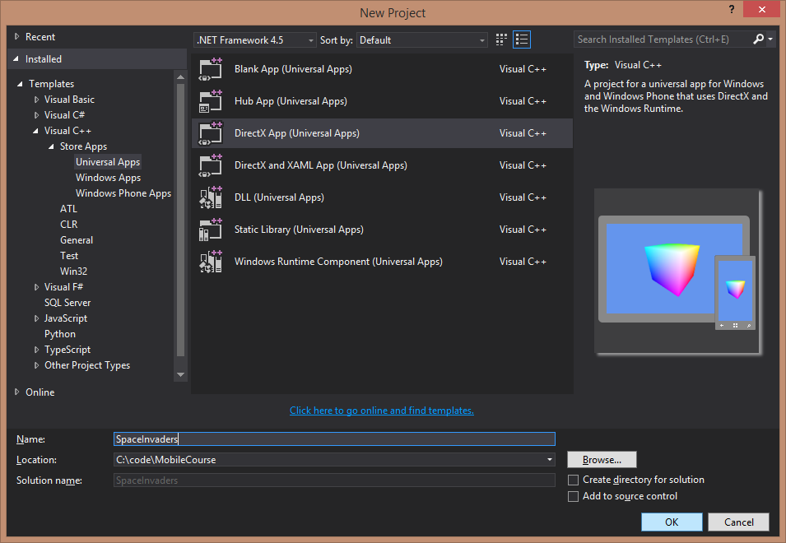
Let’s start coding

Slide 16
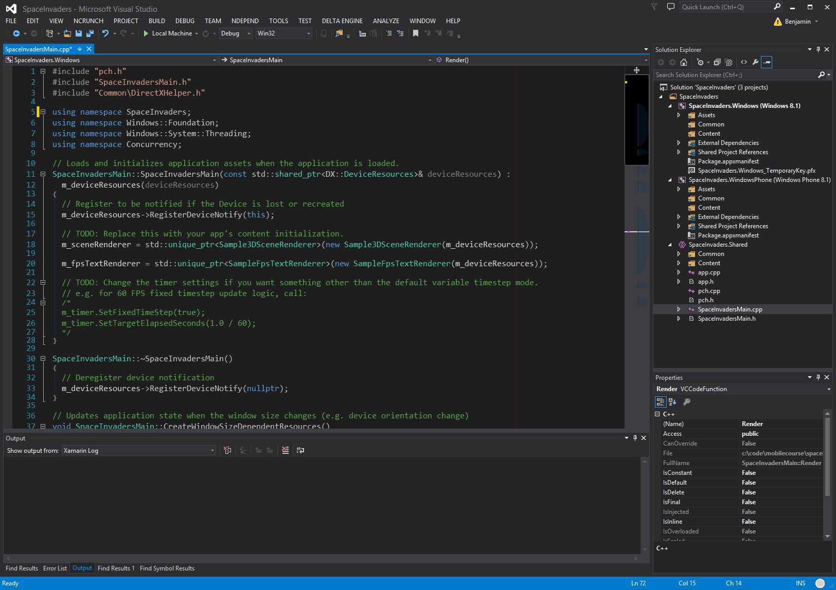
3 Simple Projects

Slide 17
Let’s test deploying nothing
Select Windows 8 project and set target
Local Machine (default)
Simulator (needs to be installed)
Remote (useful to test on other machine)
Select Windows Phone project and set target
Emulator (default)
Device (needs an unlocked Windows Phone 8)
Notes:
Show each of the options, each of these options are the same for C# Store Apps as well.

Slide 18
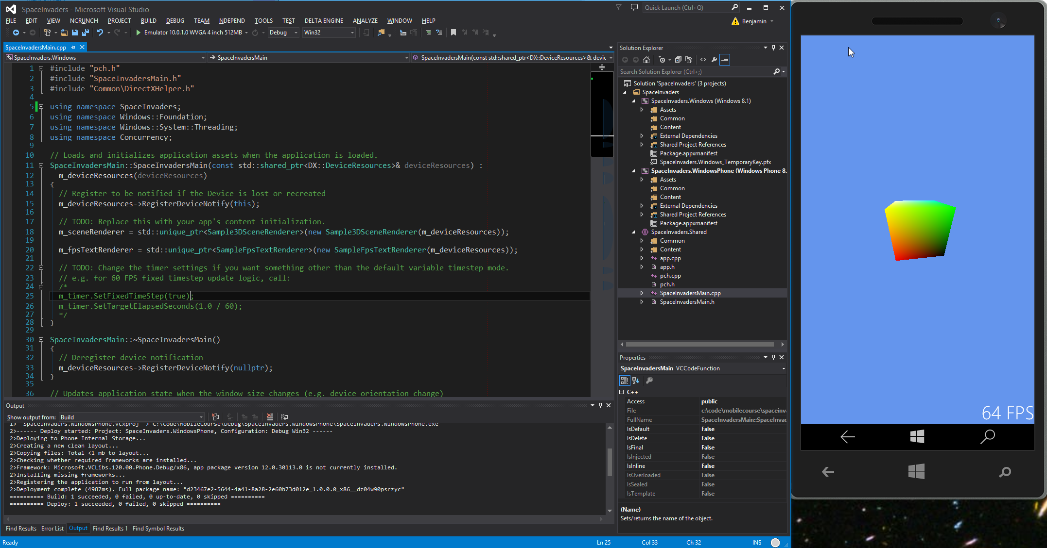
Let’s test deploying
Notes:
Show each of the options

Slide 19
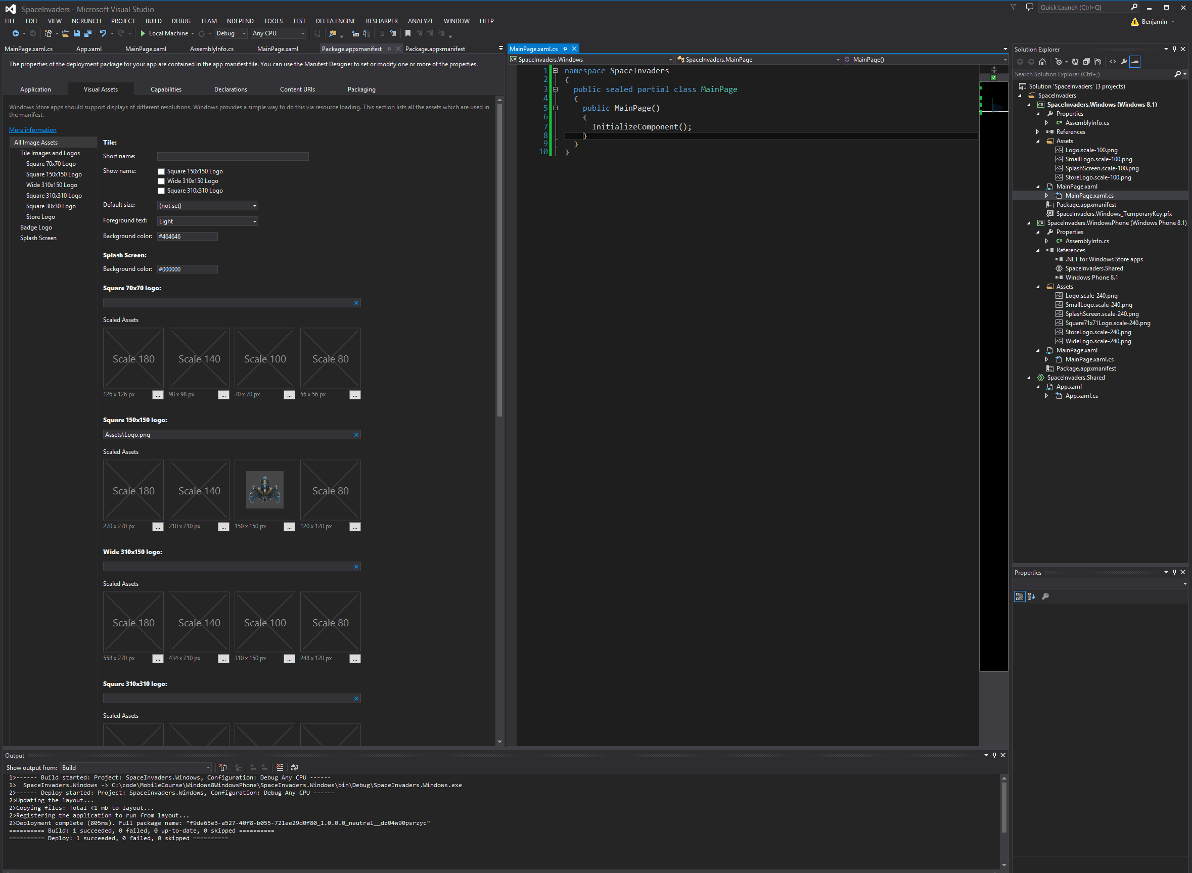
Icons & Looking at the code
Notes:
We will set all icons (copy from github assets or create your own) and set the Background to black.
There are a lot of guides on how to create the best icons and tiles, this one is pretty good for Store Apps: http://blogs.msdn.com/b/windowsappdev/archive/2012/04/16/creating-a-great-tile-experience-part-1.aspx
As usual project templates generate a lot of useless code, tips, usings and empty methods for later use. Look through all the classes, shaders, modify small things and explain.

Slide 20





Icon and Images
SpaceInvaders icons
Ship.png Missile.png Enemy.png
Search for images you want for your game on the web
Background.png
Notes:
The .ico and .rc files must be part of the Visual Studio project, all .png files must be put into the output folder (SpaceInvaders\Debug\)

Slide 21
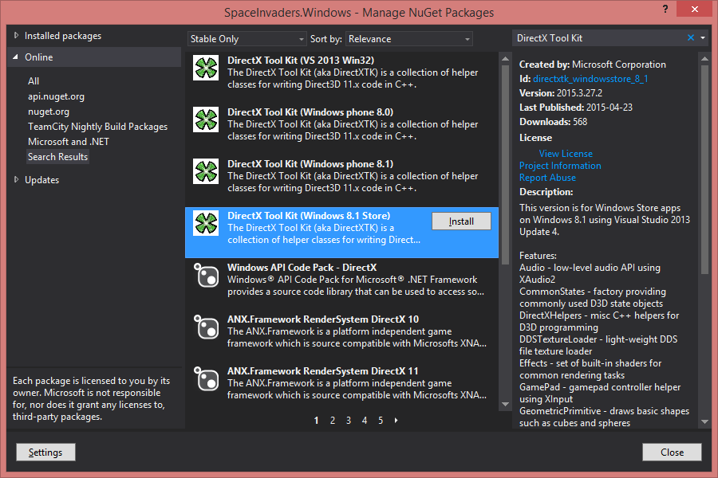
Adding DirectX Tool Kit via nuget
Notes:
Same for Windows Phone 8.1 so we can still compile both projects while adding DirectX Tool Kit code to the Shared project.

Slide 22
Live Coding
Creation of the SpaceInvaders Game
Based on C++ Course Day 2 Space Invaders game, for TDD and details check
https://github.com/BenjaminNitschke/CppCourse/Day2
First steps
https://directxtk.codeplex.com/wikipage?title=Sprites%20and%20textures
Remove all the existing SceneRenderer 3D Mesh code
Draw background, then ship and enemies + game logic
Notes:
Since we will be coding together now slides do not make so much sense, most things need to be explained and everyone should be typing his game. Links to the existing TextAdventure code will be given in the next slide, which we will only look at by the end of today.

Slide 23
Background sprite
void SpaceInvadersSceneRenderer::CreateDeviceDependentResources() { spriteBatch.reset(new SpriteBatch(m_deviceResources->GetD3DDeviceContext())); DX::ThrowIfFailed( CreateWICTextureFromFile(m_deviceResources->GetD3DDevice(), L"Background.png", nullptr, background.ReleaseAndGetAddressOf())); } void SpaceInvadersSceneRenderer::CreateWindowSizeDependentResources() { screenSize = m_deviceResources->GetOutputSize(); } void SpaceInvadersSceneRenderer::Update(DX::StepTimer const& timer) {} void SpaceInvadersSceneRenderer::Render() { spriteBatch->Begin(); RECT backgroundRect = { 0, 0, screenSize.Width, screenSize.Height }; spriteBatch->Draw(background.Get(), backgroundRect, nullptr, Colors::White); spriteBatch->End(); } void SpaceInvadersSceneRenderer::ReleaseDeviceDependentResources() { background.Reset(); spriteBatch.reset(); }
Notes:
Since we will be coding together now slides do not make so much sense, most things need to be explained and everyone should be typing his game. Links to the existing TextAdventure code will be given in the next slide, which we will only look at by the end of today.

Slide 24
Sprite class
class Sprite { public: Sprite(Microsoft::WRL::ComPtr<ID3D11ShaderResourceView> texture, float x, float y, float width, float height) : texture(texture), initialX(x), initialY(y), width(width), height(height * 2.0f) {} void Draw(std::shared_ptr<DirectX::SpriteBatch> spriteBatch, Windows::Foundation::Size screenSize, float x = 0.0f, float y = 0.0f); float GetWidth() { return width; } bool IncreaseY(float amount) { initialY += amount; return initialY > 1.0f; } float DistanceTo(std::shared_ptr<Sprite> other, float xOffset) { float distanceX = abs(initialX + xOffset - other->initialX); float distanceY = abs(initialY - other->initialY); return sqrt(distanceX*distanceX + distanceY*distanceY); } private: Microsoft::WRL::ComPtr<ID3D11ShaderResourceView> texture; float initialX; float initialY; float width; float height; };
#include "pch.h" #include "Sprite.h" using namespace SpaceInvaders; using namespace DirectX; using namespace DirectX::SimpleMath; using namespace Windows::Foundation; using namespace Microsoft::WRL; void Sprite::Draw( std::shared_ptr<DirectX::SpriteBatch> spriteBatch, Size screenSize, float x, float y) { RECT backgroundRect; backgroundRect.left = (int)((initialX + x) * screenSize.Width / 2); backgroundRect.top = (int)((initialY + y) * screenSize.Height / 2); backgroundRect.right = (int)((initialX + x + width) * screenSize.Width / 2); backgroundRect.bottom = (int)((initialY + y + height) * screenSize.Height / 2); spriteBatch->Draw(texture.Get(), backgroundRect, nullptr, Colors::White); }
Notes:
Since we will be coding together now slides do not make so much sense, most things need to be explained and everyone should be typing his game. Links to the existing TextAdventure code will be given in the next slide, which we will only look at by the end of today.

Slide 25
Windows Store Tour
Release the finished game in the Windows Store
Developer Account is needed
Unlock developer phone device
Code and test locally
Reserve App Name, Selling details, Services, Rating, etc.
Submit an app
Create package wizard
Windows App Certification Kit
Test once again and upload
Notes:
Also show device unlock tool (register developer phone) and custom deploy tool. Release website: https://appdev.microsoft.com/StorePortals/en-US/Developer/Catalog/ReleaseAnchor
Good step by step guide (bit outdated, but still valid information in there): https://books.google.de/books?id=NyyyEwWxpF0C&pg=PA178&lpg=PA178&dq=programming+space+invaders+c%23+windows+phone&source=bl&ots=DVEgqTXtiO&sig=bbn-0IZnxq-tVJWm3Q4Z4C7IXQo&hl=en&sa=X&ved=0CFYQ6AEwB2oVChMI4pXt7s6SxgIV5Y5yCh0B_wDE#v=onepage&q=programming%20space%20invaders%20c%23%20windows%20phone&f=false

Slide 26
Questions?
All code and these slides are available at:
https://github.com/BenjaminNitschke/MobileCourse

Slide 27
Links
DirectX Walkthroughs: https://msdn.microsoft.com/en-us/library/windows/apps/hh465149.aspx
http://blogs.msdn.com/b/windowsappdev/archive/2012/04/16/creating-a-great-tile-experience-part-1.aspx
https://directxtk.codeplex.com
http://sharpdx.org/
http://www.monogame.net/
http://channel9.msdn.com/coding4fun/blog/Sharpening-your-Metro-CXAML-projects-with-DirectX-and-SharpDX

